Slide 1
The Muffin Problem REU CAAR 2019

Slide 2
What is the muffin problem?
You have 5 muffins and 3 students. You want to
divide the muffins evenly, but no student wants a
tiny sliver. What division of muffins maximizes
the smallest piece? ^{[1]}
^{by Alan Frank}

Slide 3

What is one way to divide the muffins?
2/3
2/3
1
1
1
1/3
1/3
Notes:
Ask audience

Slide 4
Can we do better?
YES!
Notes:
Better = bigger smallest piece

Slide 5
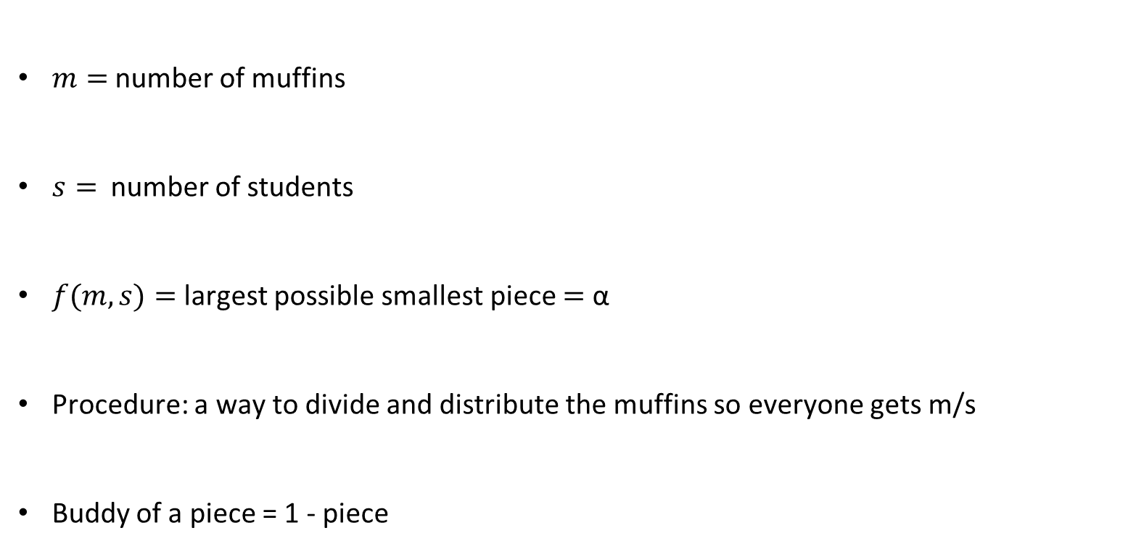
Notation
$m=$ number of muffins
$s=$ number of students
$f(m,s)=$largest possible smallest piece $=$ α
Procedure: a way to divide and distribute the muffins so everyone gets m/s
Buddy of a piece = 1 - piece
2/3
1/3

Slide 6
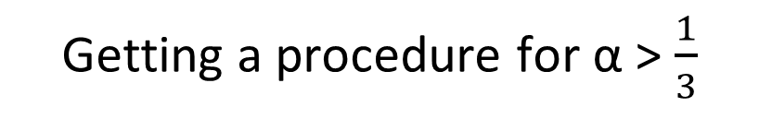
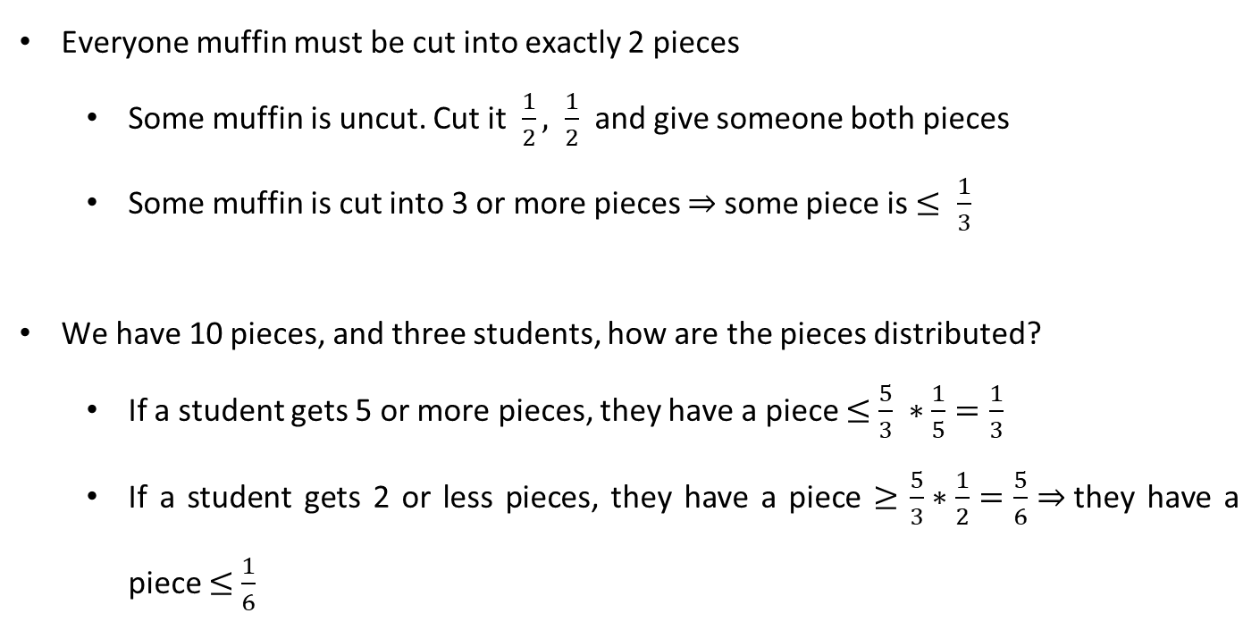
Getting a procedure for α > $\frac{1}{3}$
Everyone muffin must be cut into exactly 2 pieces
Some muffin is uncut. Cut it $\frac{1}{2}, \frac{1}{2}$and give someone both pieces
Some muffin is cut into 3 or more pieces $⇒$some piece is $≤ \frac{1}{3}$
We have 10 pieces, and three students, how are the pieces distributed?
If a student gets 5 or more pieces, they have a piece $≤$ $\frac{5}{3} ∗\frac{1}{5}=\frac{1}{3}$
If a student gets 2 or less pieces, they have a piece $≥$ $\frac{5}{3}∗\frac{1}{2}=\frac{5}{6}⇒$they have a piece $≤$ $\frac{1}{6}$

Slide 7
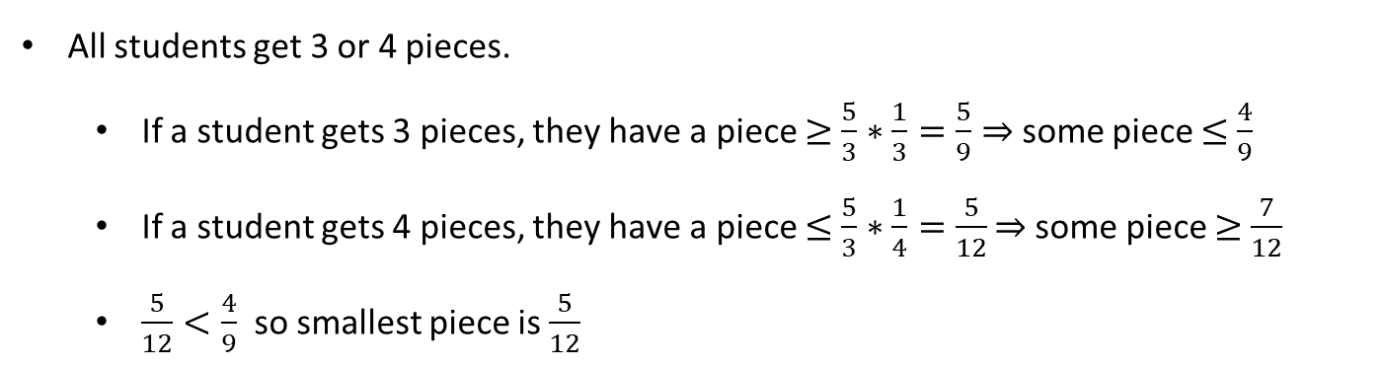
Getting a procedure for α > $\frac{1}{3}$
All students get 3 or 4 pieces.
If a student gets 3 pieces, they have a piece $≥$ $\frac{5}{3}∗\frac{1}{3}=\frac{5}{9}⇒$some piece $≤$ $\frac{4}{9}$
If a student gets 4 pieces, they have a piece $≤$ $\frac{5}{3}∗\frac{1}{4}=\frac{5}{12}$ $⇒$some piece $≥$ $\frac{7}{12}$
$\frac{5}{12}<\frac{4}{9}$ so smallest piece is $\frac{5}{12}$

Slide 8
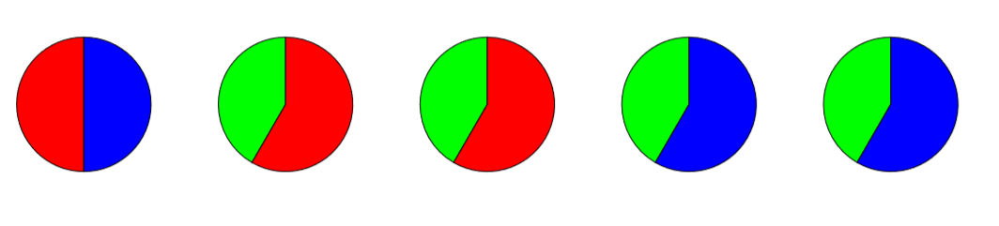
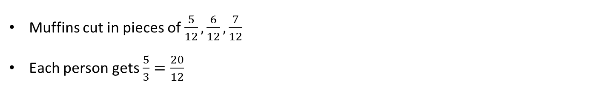
Let’s approach the problem systematically
Muffins cut in pieces of $\frac{5}{12},\frac{6}{12},\frac{7}{12}$
Each person gets $\frac{5}{3}=\frac{20}{12}$
1/2
1/2
5/12
5/12
5/12
5/12
7/12
7/12
7/12
7/12

Slide 9
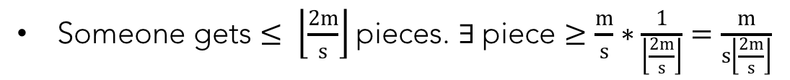
In General :: Floor Ceiling Theorem (FC)
Every muffin is cut into 2 pieces, so 2m pieces.
Someone gets $≥ \left\lceil \frac{2m}{s}\right\rceil$pieces. $∃$piece $≤\frac{m}{s} ∗\frac{1}{\left\lceil \frac{2m}{s}\right\rceil }=\frac{m}{s\left\lceil 2m/s\right\rceil }$
Someone gets $≤ \left\lfloor \frac{2m}{s}\right\rfloor$pieces. $∃$piece $≥\frac{m}{s}∗\frac{1}{\left\lfloor \frac{2m}{s}\right\rfloor }=\frac{m}{s\left\lfloor \frac{2m}{s}\right\rfloor }$
The other piece from that muffin is of size $≤1−\frac{m}{s\left\lfloor \frac{2m}{s}\right\rfloor }$

Slide 10
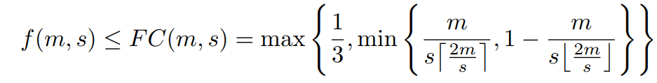
In General :: Floor Ceiling Theorem (FC)

Slide 11
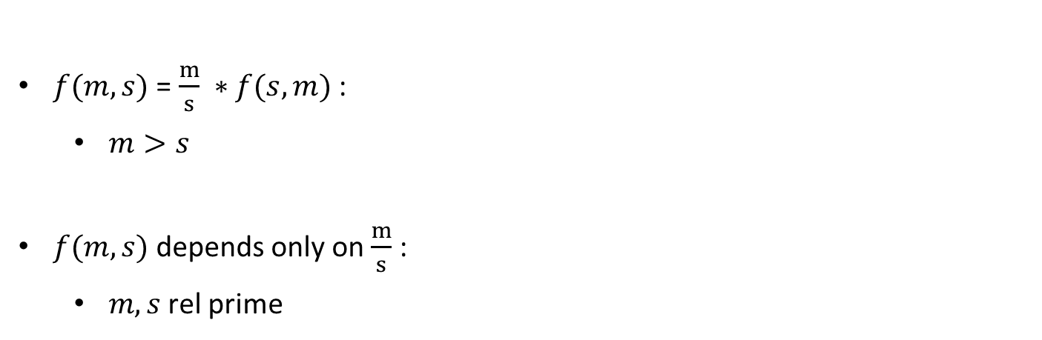
Gathering Data
$f(m,s)$ = $\frac{m}{s} ∗f(s,m)$ :
$m>s$
$f(m,s)$ depends only on $\frac{m}{s}$ :
$m,s$rel prime
Notes:
F(m,s) = m/s*F(s,m) – Theorem
F(m,s) depends on ratio well believed conjecture

Slide 12
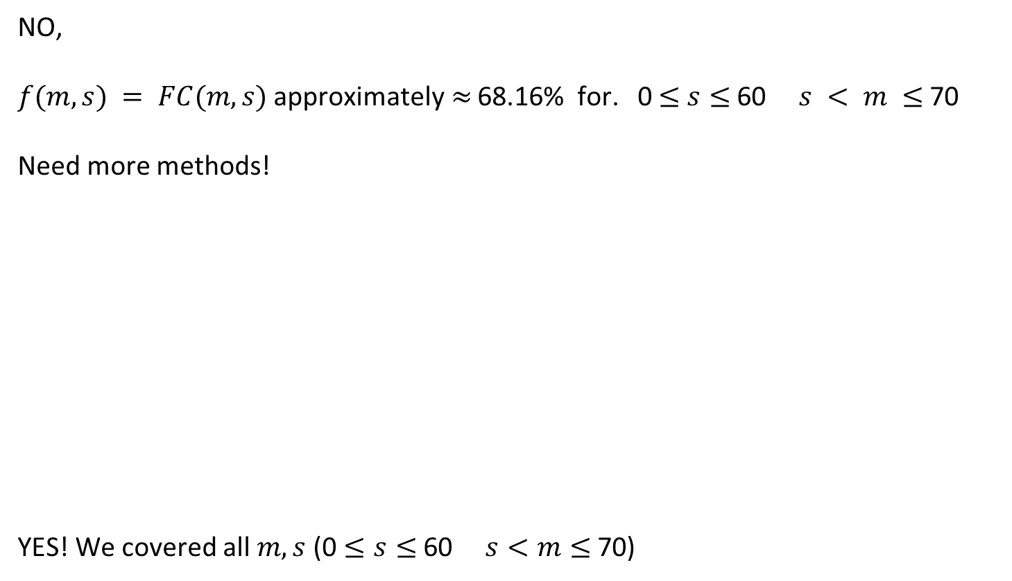
Does f(m,s) = FC(m,s) ∀ m,s?
NO,
$f(m,s) = FC(m,s)$approximately$≈$ 68.16% for. 0 $≤$ $s≤$60 $s < m ≤$70
Need more methods!
YES! We covered all $m,s$ (0 $≤s$ $≤$60 $s<m≤$70)
HALF | 10.07%
INT | 6.47%
MID | 3.38%
EBM | 5.22%
HBM | 1.84%
GAP | 4.71%
TRAIN | 0.015%
Notes:
We ran FC on students going from 0 to 60 and muffins going from students to 70 and FC worked for 68%
Half worked for 10% of what FC didn’t work for
We don’t have time to go into detail about the other methods… they get a lot harder

Slide 13
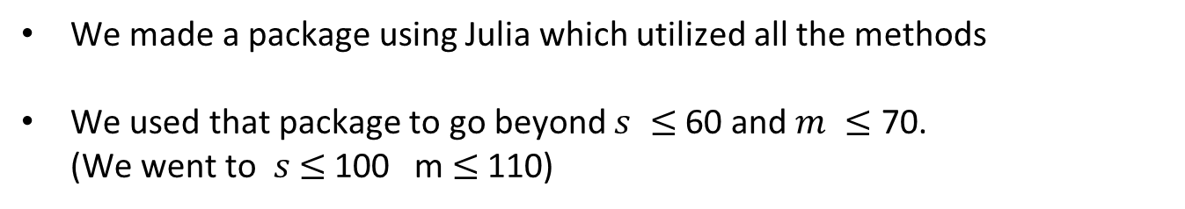
What we did
We made a package using Julia which utilized all the methods
We used that package to go beyond $s ≤$60 and $m ≤$ 70. (We went to $s$ $≤$100 m $≤$110)
 | OLD DATA | NEW DATA
FC | 68.16% | 64.94%
HALF | 10.07% | 9.15%
INT | 6.47% | 6.68%
MID | 3.38% | 3.07%
EBM | 5.22% | 5.63%
HBM | 1.84% | 2.53%
GAP | 4.71% | 6.79%
TRAIN | 0.015% | ---------
Notes:
We started the summer with all this knowledge, and this is what we did with it.
Old data took 7 hours to get to 60,70 and had errors, our package takes 3.5 hours to get to 100,110 and doesn’t have known errors

Slide 14
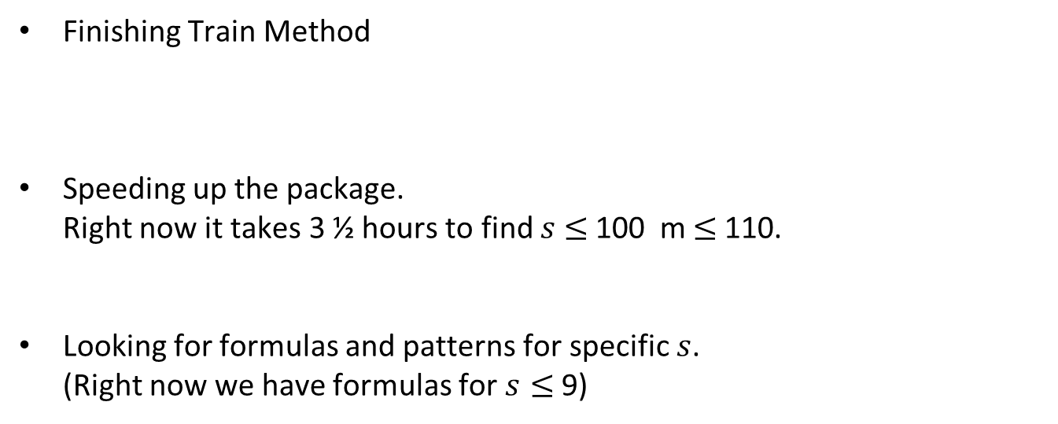
What are we doing?
Finishing Train Method
Speeding up the package. Right now it takes 3 ½ hours to find $s$ $≤$100 m $≤$110.
Looking for formulas and patterns for specific $s$. (Right now we have formulas for $s≤$9)

Slide 15
Applications?
Cutting pizza
Cutting cake
Cutting Diamonds…?
We take suggestions
And now a short video

Slide 16
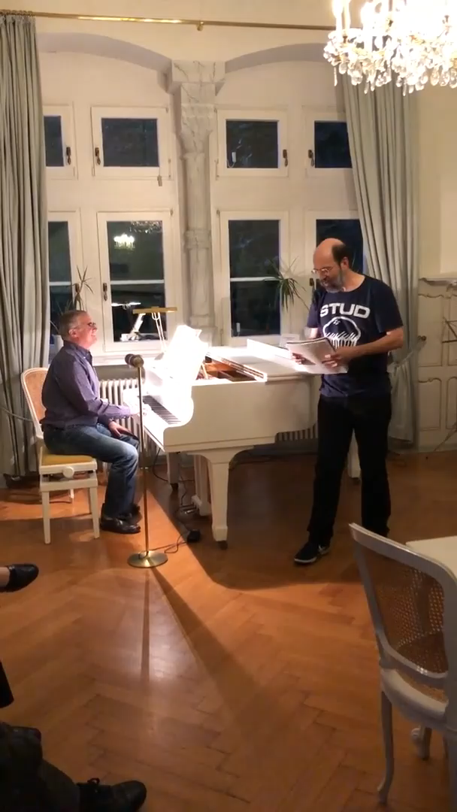
Muffin Song

Slide 17
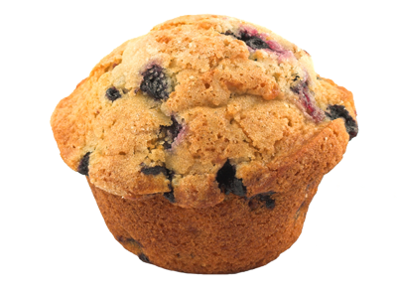
Questions?

Slide 18
Questions?
References
[1] The Muffin Puzzle
Invented by Recreational Mathematician Alan Frank
Described by Jeremy Copeland in
The New York Times Numberplay Online Blog
wordplay.blogs.nytimes.com/2013/08/19/cake
PowerPoint Template: SlideCarnival

